Slide 1
Delay-Aware Model-Based Reinforcement Learning for Continuous Control
Baiming Chen, Mengdi Xu, Liang Li, Ding Zhao

Slide 2
Contributions
Formally define the mult-step delayed MDP and prove it can be converted to standard MDP via the Markov reward process.
Propose a general framework of delay-aware model-based reinforcement learning for continuous control tasks.
Develop the delay-aware trajectory sampling (DATS) algorithm which can efficiently solve delayed MDPs with minimal degradation of performance.

Slide 3
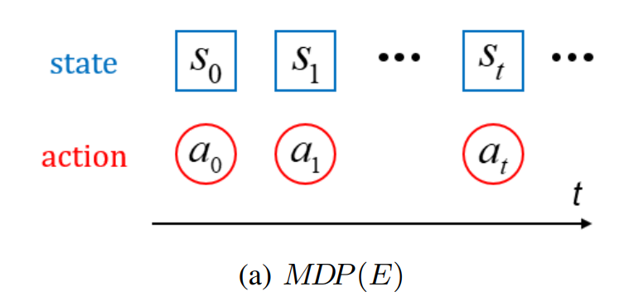
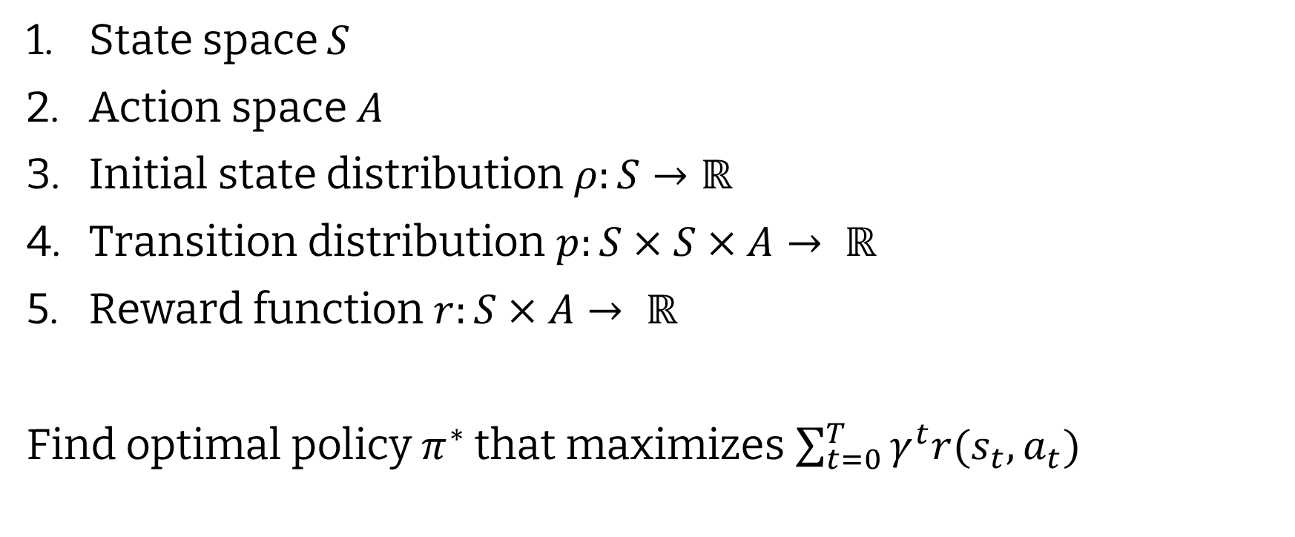
Delay-Free MDP
State space $S$
Action space $A$
Initial state distribution$ρ:S→ℝ$
Transition distribution $p:S×S×A→ ℝ$
Reward function $r:S×A→ ℝ$
Find optimal policy $π^{∗}$ that maximizes $\sum_{t=0}^{T}{γ^{t}r(s_{t}, a_{t})}$

Slide 4
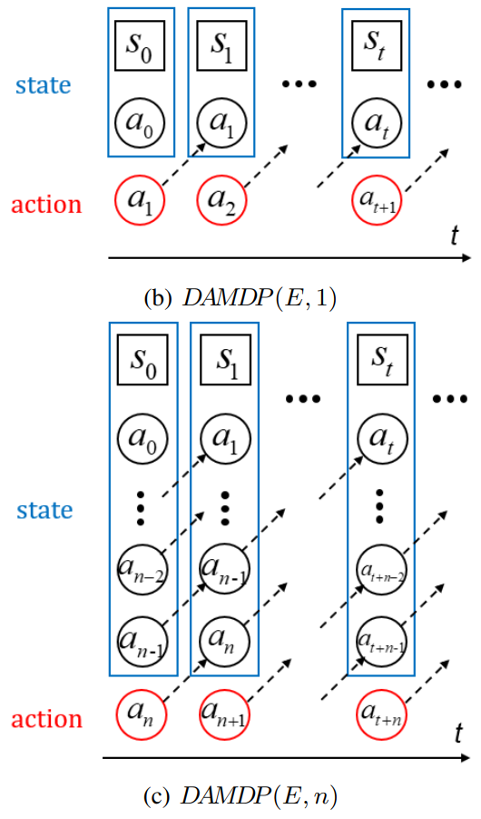
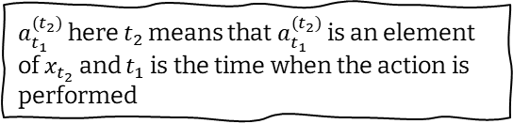
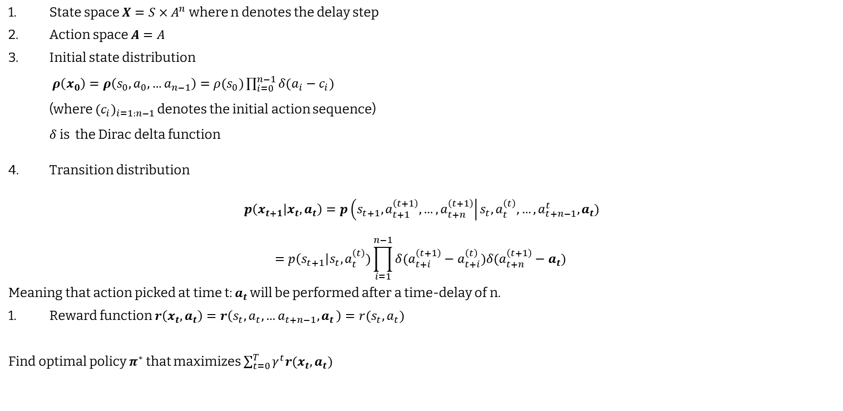
Delay-Aware MDP
Key: Bold -> DA-MDP
Normal -> MDP
$a_{t_{1}}^{{(t}_{2})}$ here $t_{2}$ means that $a_{t_{1}}^{{(t}_{2})}$ is an element of $x_{t_{2}}$ and $t_{1}$ is the time when the action is performed
State space $X=S×A^{n}$ where n denotes the delay step
Action space $A=A$
Initial state distribution $ρ\left(x_{0}\right)=ρ\left(s_{0},a_{0},…a_{n−1}\right)=ρ(s_{0})\prod_{i=0}^{n−1}{δ(a_{i}−c_{i})}$ (where ${{(c}_{i})}_{i=1:n−1}$ denotes the initial action sequence) $δ$ is the Dirac delta function
Transition distribution
$$p\left(x_{t+1} | x_{t}, a_{t}\right)=p\left(s_{t+1},a_{t+1}^{\left(t+1\right)},…, a_{t+n}^{\left(t+1\right)}\right|s_{t}, a_{t}^{\left(t\right)}, …, a_{t+n−1}^{t}, a_{t})$$
$$=p\left(s_{t+1}\right|s_{t}, a_{t}^{\left(t\right)})\prod_{i=1}^{n−1}{δ(a_{t+i}^{\left(t+1\right)}−a_{t+i}^{\left(t\right)})δ(a_{t+n}^{\left(t+1\right)}−a_{t})}$$
Meaning that action picked at time t: $a_{t}$ will be performed after a time-delay of n.
Reward function $r\left(x_{t}, a_{t}\right)=r\left(s_{t}, a_{t},…a_{t+n−1}{,a}_{t}\right)=r(s_{t},a_{t})$
Find optimal policy $π^{∗}$ that maximizes $\sum_{t=0}^{T}{γ^{t}r(x_{t}, a_{t})}$

Slide 5
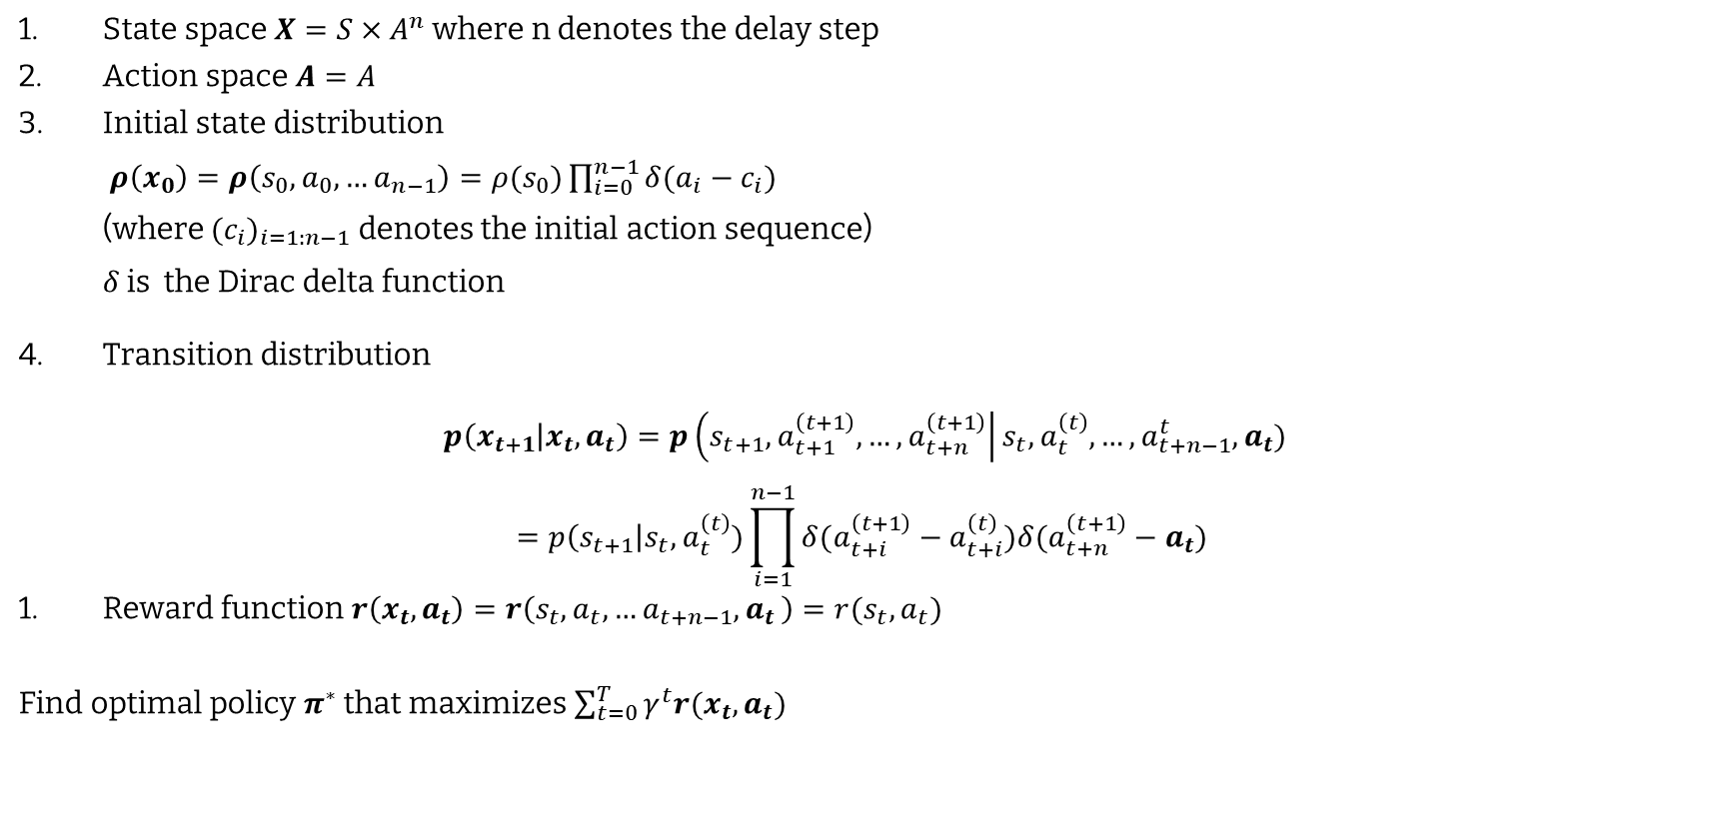
Delay-Aware MDP explanation
State space is now augmented to contain the state at time t and the n actions taken from time t to t+n.
State space $X=S×A^{n}$ where n denotes the delay step
Action space $A=A$
Initial state distribution $ρ\left(x_{0}\right)=ρ\left(s_{0},a_{0},…a_{n−1}\right)=ρ(s_{0})\prod_{i=0}^{n−1}{δ(a_{i}−c_{i})}$ (where ${{(c}_{i})}_{i=1:n−1}$ denotes the initial action sequence) $δ$ is the Dirac delta function
Transition distribution
$$p\left(x_{t+1} | x_{t}, a_{t}\right)=p\left(s_{t+1},a_{t+1}^{\left(t+1\right)},…, a_{t+n}^{\left(t+1\right)}\right|s_{t}, a_{t}^{\left(t\right)}, …, a_{t+n−1}^{t}, a_{t})$$
$$=p\left(s_{t+1}\right|s_{t}, a_{t}^{\left(t\right)})\prod_{i=1}^{n−1}{δ(a_{t+i}^{\left(t+1\right)}−a_{t+i}^{\left(t\right)})δ(a_{t+n}^{\left(t+1\right)}−a_{t})}$$
Reward function $r\left(x_{t}, a_{t}\right)=r\left(s_{t}, a_{t},…a_{t+n−1}{,a}_{t}\right)=r(s_{t},a_{t})$
Find optimal policy $π^{∗}$ that maximizes $\sum_{t=0}^{T}{γ^{t}r(x_{t}, a_{t})}$
The initial state distribution is basically the distribution of the initial state and the initial action sequence.
So the transition distribution is describing that all actions that are shared between two states should be the same along with the original transition function.
Reward function remains unchanged.
Key: Bold -> DA-MDP
Normal -> MDP

Slide 6
Action delay vs observation delay
From the point of view of the agent, they form the same mathematical problem.
Katsikopoulos, Konstantinos V., and Sascha E. Engelbrecht. "Markov decision processes with delays and asynchronous cost collection." IEEE transactions on automatic control 48.4 (2003): 568-574.

Slide 7
Action Delay
There are two components:
Action selection: The complexity of algorithm matters. (can be adaptive using QuickNets)
Action actuation: The hardware matters. (Different actuators might have different response times and can be incorporated into the connections at various levels of the network.)
Since the action needs to be available at the next step, the action selection delay can be at most 1. To adapt to this, the time step is chosen larger than the action selection.
Thus it would make sense that rather than each exit working on a different delay which would work in case of different actuators, we require each exit working on a different time step. So each input is propagated all the way trough, an the time step of each exit is determined by their processing speed. Thus, early exits will allow a trade-off between granular actions vs more processing.

Slide 8
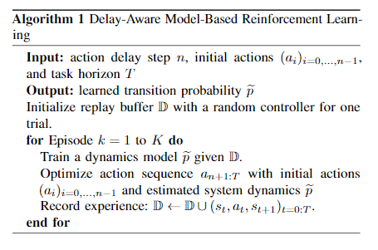
Algorithm

Slide 9
Model-free vs Model-based
For n>1, model free is challenging since we learn the effect of an action only after n-step updates of the bellman equation.
Also, model free algorithms cannot handle a change in n.

